Slide 1


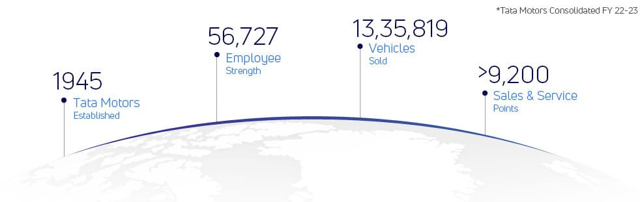
TATA MOTORS
Swathi.S
Akhila.G
Devi.R
Vasu.B
Prudhvi.G

Slide 2
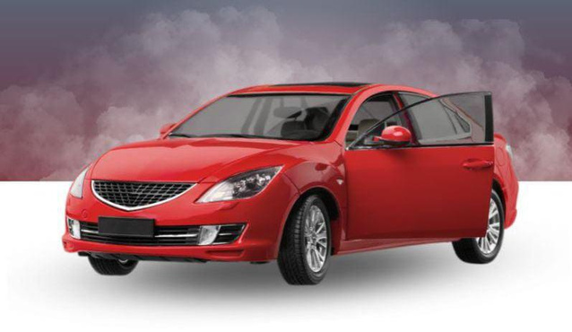



synopsis of Tata Motors
Mission
Vision
Values
Tata motors innovate mobility solutions with passion to enhance the quality of life.To deliver value through tata products and services and to be the most trusted global network for customers and suppliers.
By FY 2024,Tata motors will become the most aspirational Indian auto brand, consistently winning, by:- Driving sustainable mobility solutions - Exceeding customer expectations.
We innovate mobility solutions with passion to enhance the quality of life.
- Integrity - Teamwork - Accountability - Customer focus - Excellence - Speed

Slide 3
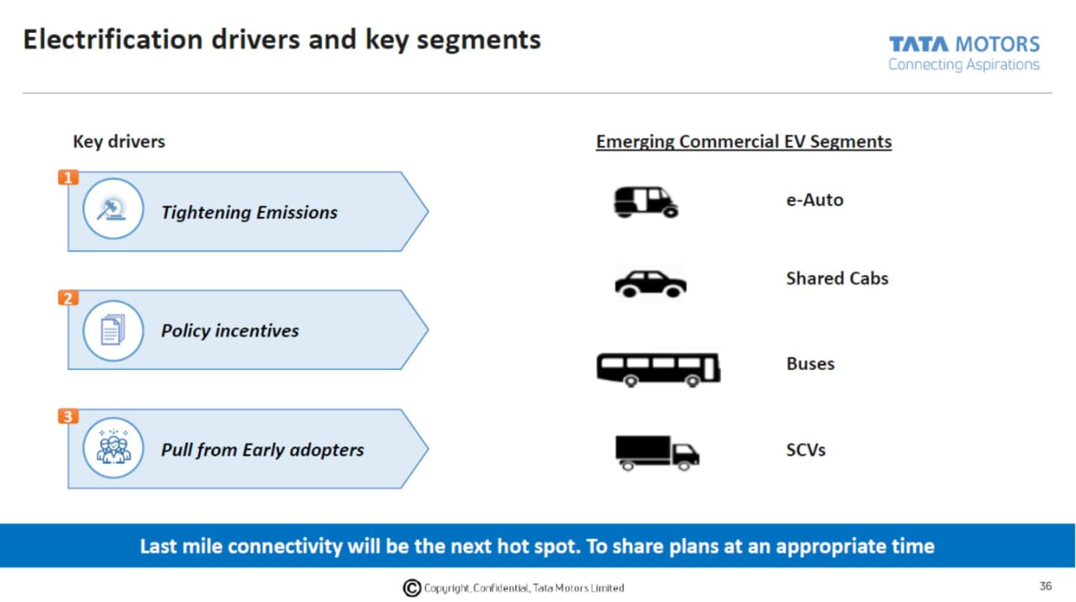
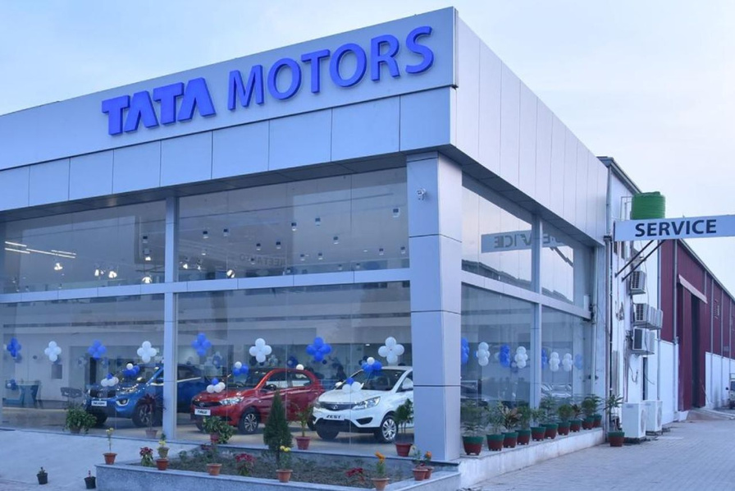
Brand Analysis
Brand Tone
The brand tone for Tata Motors is typically professional, forward-looking, and focused on delivering innovative solutions. They often emphasize their commitment to customer satisfaction, quality, and their role in shaping the future of mobility.
Unique Selling Point
Recognising this trend, Tata Motors took a risk by emphasising safety as a selling point. They recognised that the strength and safety of a vehicle should be the top priority for car buyers

Slide 4
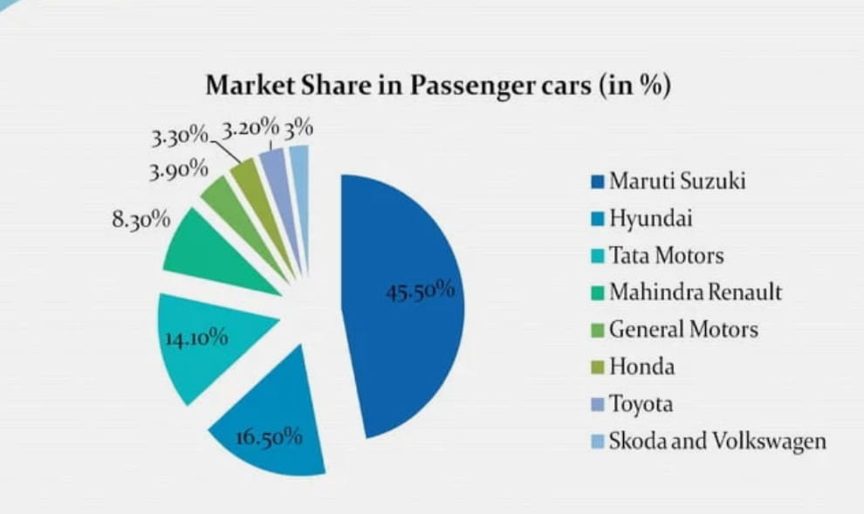
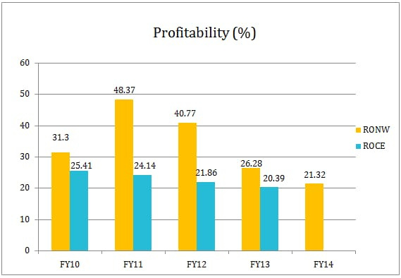
Customer Behaviour and Demographics

Slide 5
Audience demographics
77.7 Male
Tata Motors primarily caters to a diverse range of audience demographics, depending on the specific product and market segment.
22.93 Female
25 - 34 Years
Age group of people

Slide 6


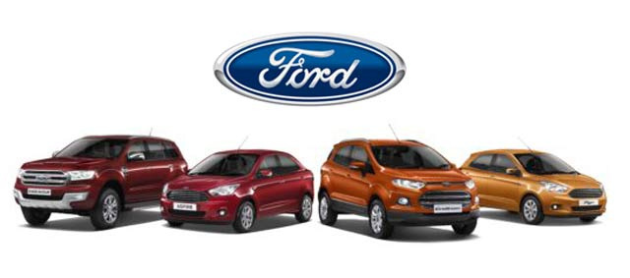
Competitors Analysis

Slide 7
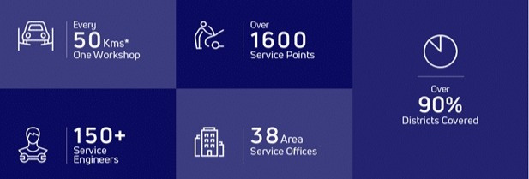
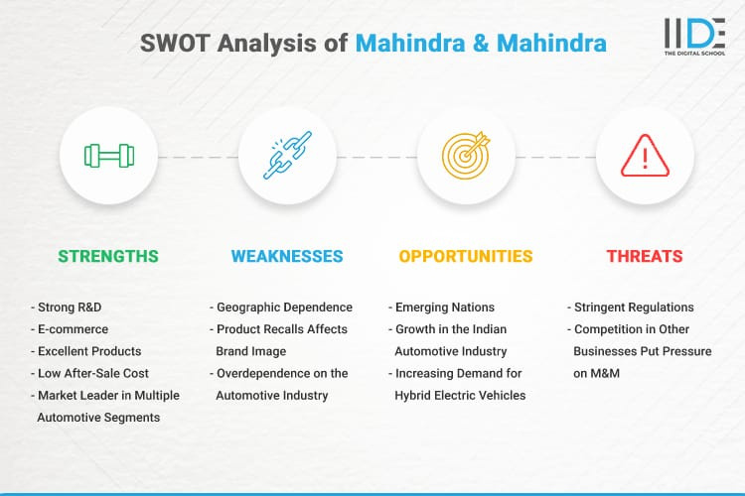
TATA MOTORS
Competitors Analysis
Mahindra
USP:Mahindra SUV’s have a stronghold in the Indian commercial taxi market which have good performance o tough terrains

Slide 8
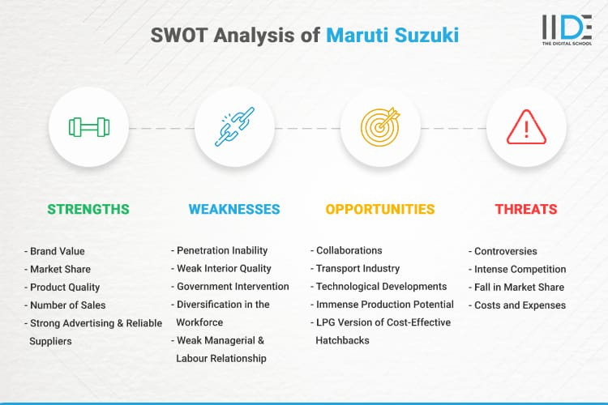
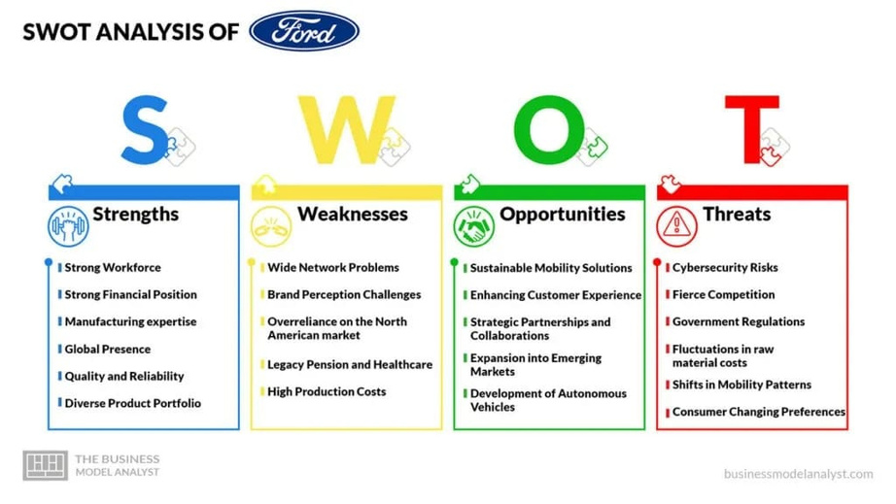
Maruti Suzuki
USP:Maruti has car models in every segment with a wide price range to choose from, apart from being the most reliable name in Indian automobile market
Ford
USP:Ford has an international brand presence due to one of the oldest car manufacturing company and also provides a wide range of cars

Slide 9
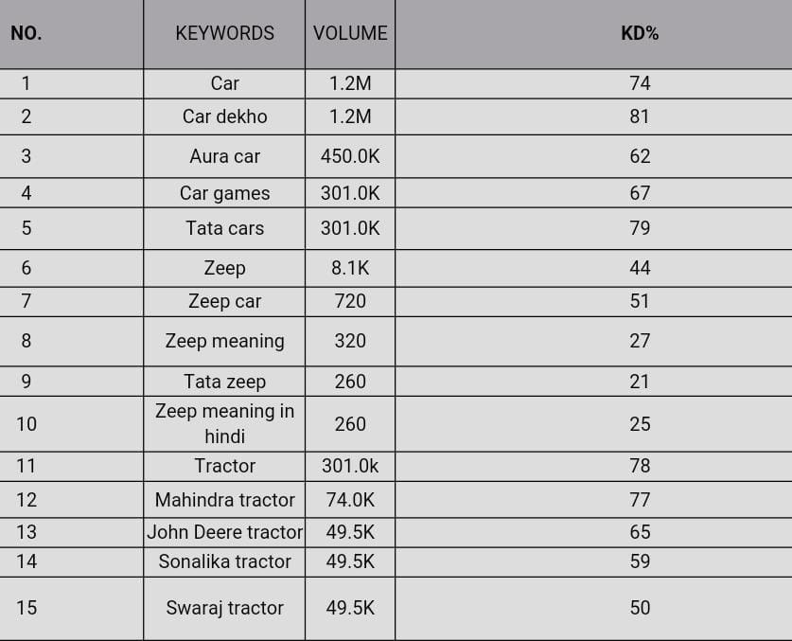
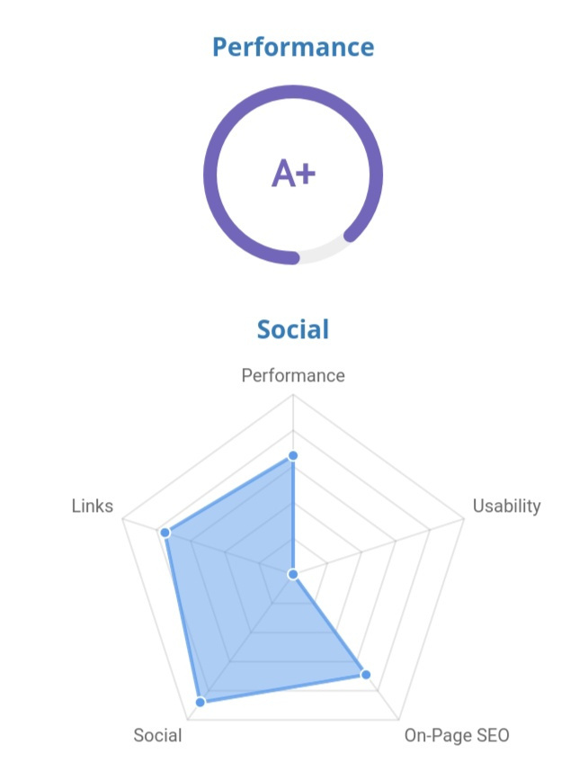
SEO AUDIT

Slide 10
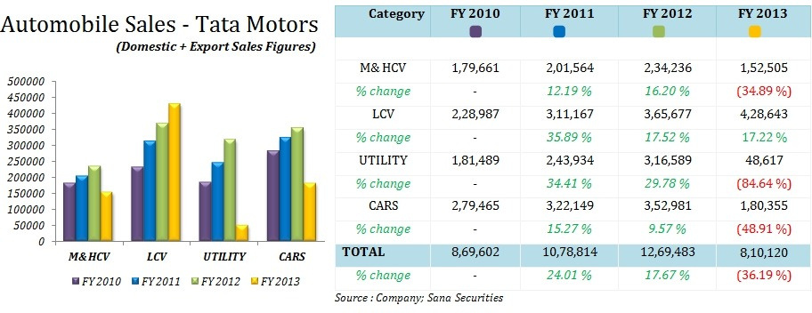
ON PAGE OPTIMIZATION

Slide 11
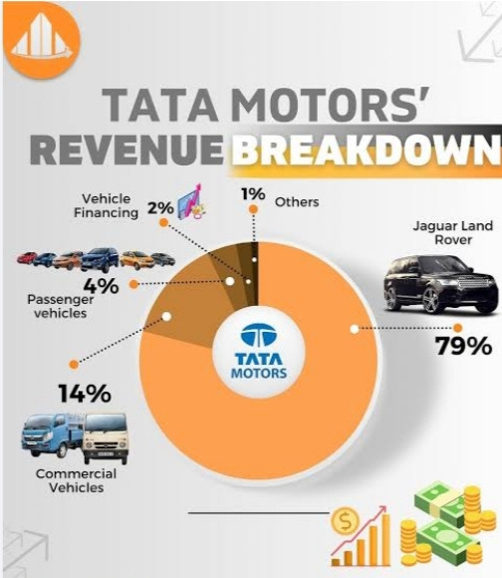
Revenue Breakdown of Tatamotors

Slide 12


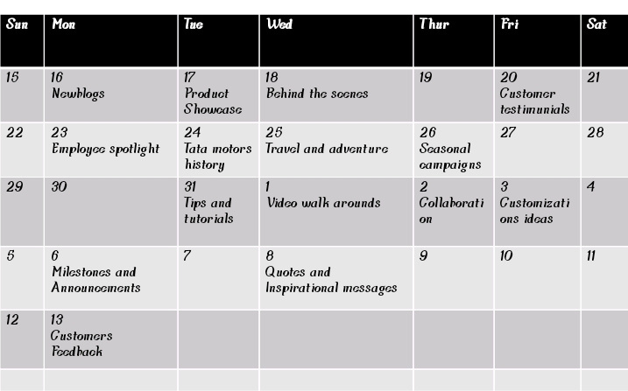



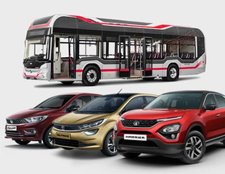
Calender on content Creation
October 15th - November 13th

Slide 13
Content Creation
Instagram page link
https://instagram.com/tatamilestone?igshid=MzRlODBiNWFlZA==
Instagram post link
https://www.instagram.com/p/CyVIb_4xbGB/?igshid=MmU2YjMzNjRlOQ==
Instagram Carousel post
https://www.instagram.com/p/CyVJc6-xBRc/?igshid=MmU2YjMzNjRlOQ==

Slide 14
Instagram Story
Instagram page link
https://instagram.com/tatamilestone?igshid=MzRlODBiNWFlZA==
Instagram Story link
https://instagram.com/stories/tatamilestone/3212603290957405122?utm_source=ig_story_item_share&igshid=NjZiM2M3MzIxNA==
Instagram Highlight link
https://www.instagram.com/s/aGlnaGxpZ2h0OjE3OTE1NjE0NDY2ODExMzI4?story_media_id=3212603290957405122_62497529045&igshid=NTc4MTIwNjQ2YQ==

Slide 15


